Slide 1



Slide 2
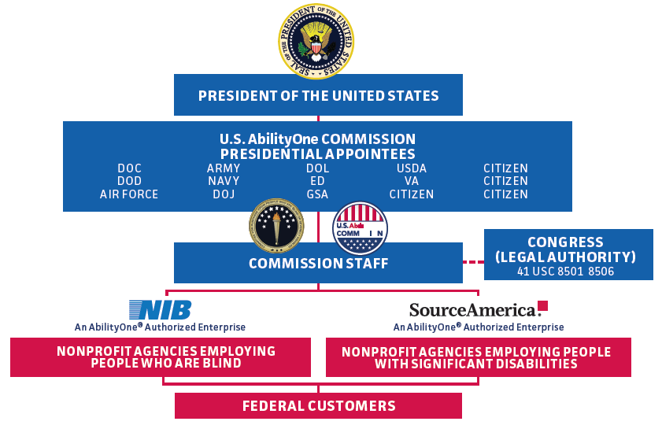
AbilityOne Program Structure

Slide 3
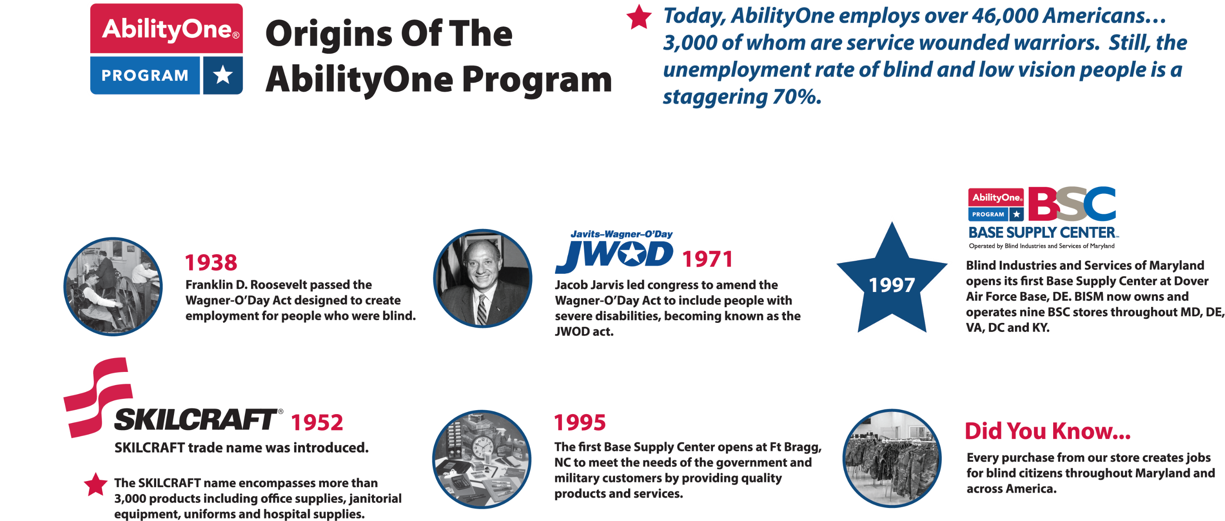

Slide 4

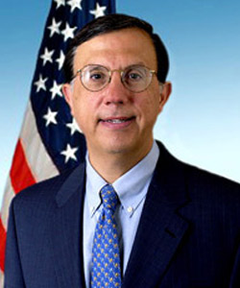
AbilityOne Program Support
“While I recognize that we are the largest
AbilityOne customer, we have the responsibility
and tremendous opportunity to increase
employment for this community by procuring
more quality goods and services from the
AbilityOne Program. I urge all contracting officials to make a personal commitment to consider, when appropriate, the AbilityOne Program in fulfilling procurement needs.”
Shay D. Assad
Assistant Secretary of Defense for Acquisition and
Director, Defense Procurement and Acquisition Policy
U.S. Department of Defense
August 27, 2008

Slide 5
What Are AbilityOne Base Supply Centers?
Started in 1995 to create a “One-Stop Shop” experience for Government (Military, Federal, Civilians & Contractors) customers to support mission requirements.
This special partnering relationship between the military/federal organizations and the AbilityOne BSC Program were designed to meet the customer demands and to create employment opportunities for people who are blind and or severely disabled, both locally and across the Nation. Today 21 Agencies operate 154 BSCs throughout the country that have created more than 1,000 blind jobs.
Base Supply Centers (BSCs) offer a full line of AbilityOne and Commercial office supplies, janitorial and sanitation products, furniture, medical and safety items, individual equipment and organizational clothing, tactical gear, tools, maintenance and repair products and much, much more to fulfill mission requirements.

Slide 6













BSC – Business Partnerships
AbilityOne manufacturing Agencies
Wholesalers
Small Businesses
GSA
Other Sources
Government Customers

Slide 7
Base Supply Centers Benefits
Base Supply Centers provide service-disabled veterans and military dependents opportunities to join the BSC Team, where they continue to play a valuable role in the military communities that are significant in their lives.
BSCs reduce administrative cost by eliminating procurement lead-time, providing transaction cost savings, and reducing procurement workload.
When purchasing from the Base Supply Centers, government customers support the employment of qualified professionals who are blind or have other severe disabilities.
BSCs provide a safe haven shopping experience for government compliance requirements. Store sanitized for Essentially the Same (ETS) Products to ensure AbilityOne products are available where mandatory use is required.

Slide 8

Base Supply Center “Rules of the Road”
Authorized Shoppers: Government/Federal/Military Employees & Government Contractors
National Defense Authorization Act increased Micro-purchase Threshold to $10,000
Green Compliant products and AbilityOne products featured and identified
No personal purchases allowed in BSC
BSC’s carry Berry Compliant Uniforms for Individual Equipment Element (IEE)
Level 3 Credit Card Reporting
How to Shop with us: Walk-in, Fax, Email, Phone and online (www.shopbism.com)
Customer Product Suggestions Encouraged

Slide 9
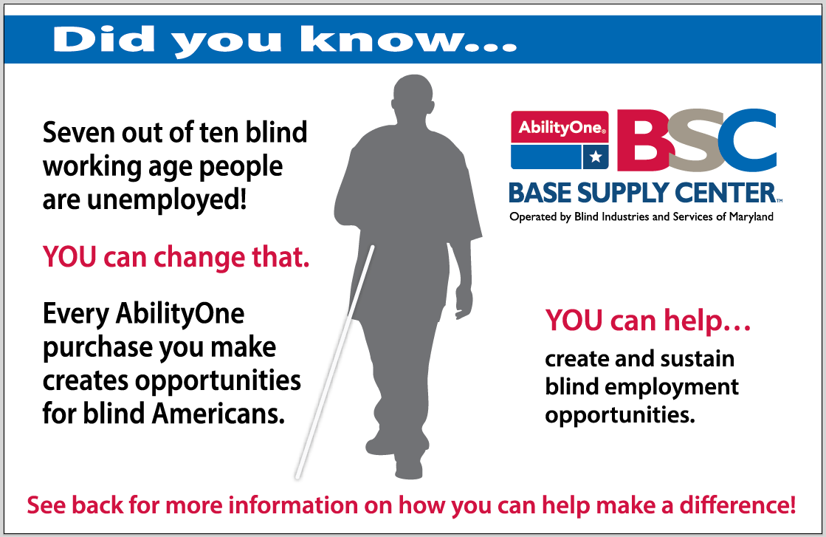

Slide 10
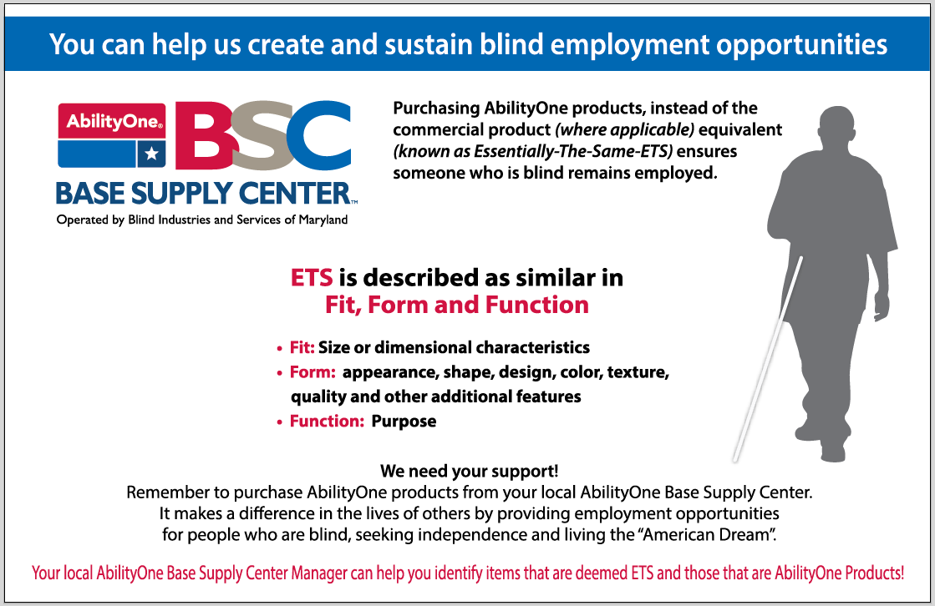

Slide 11
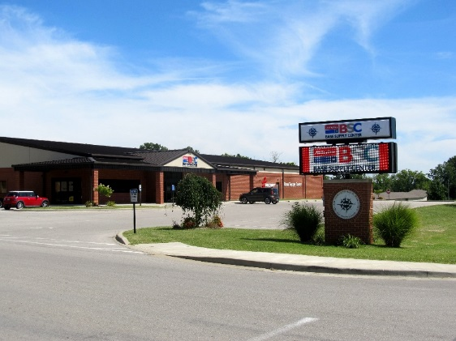
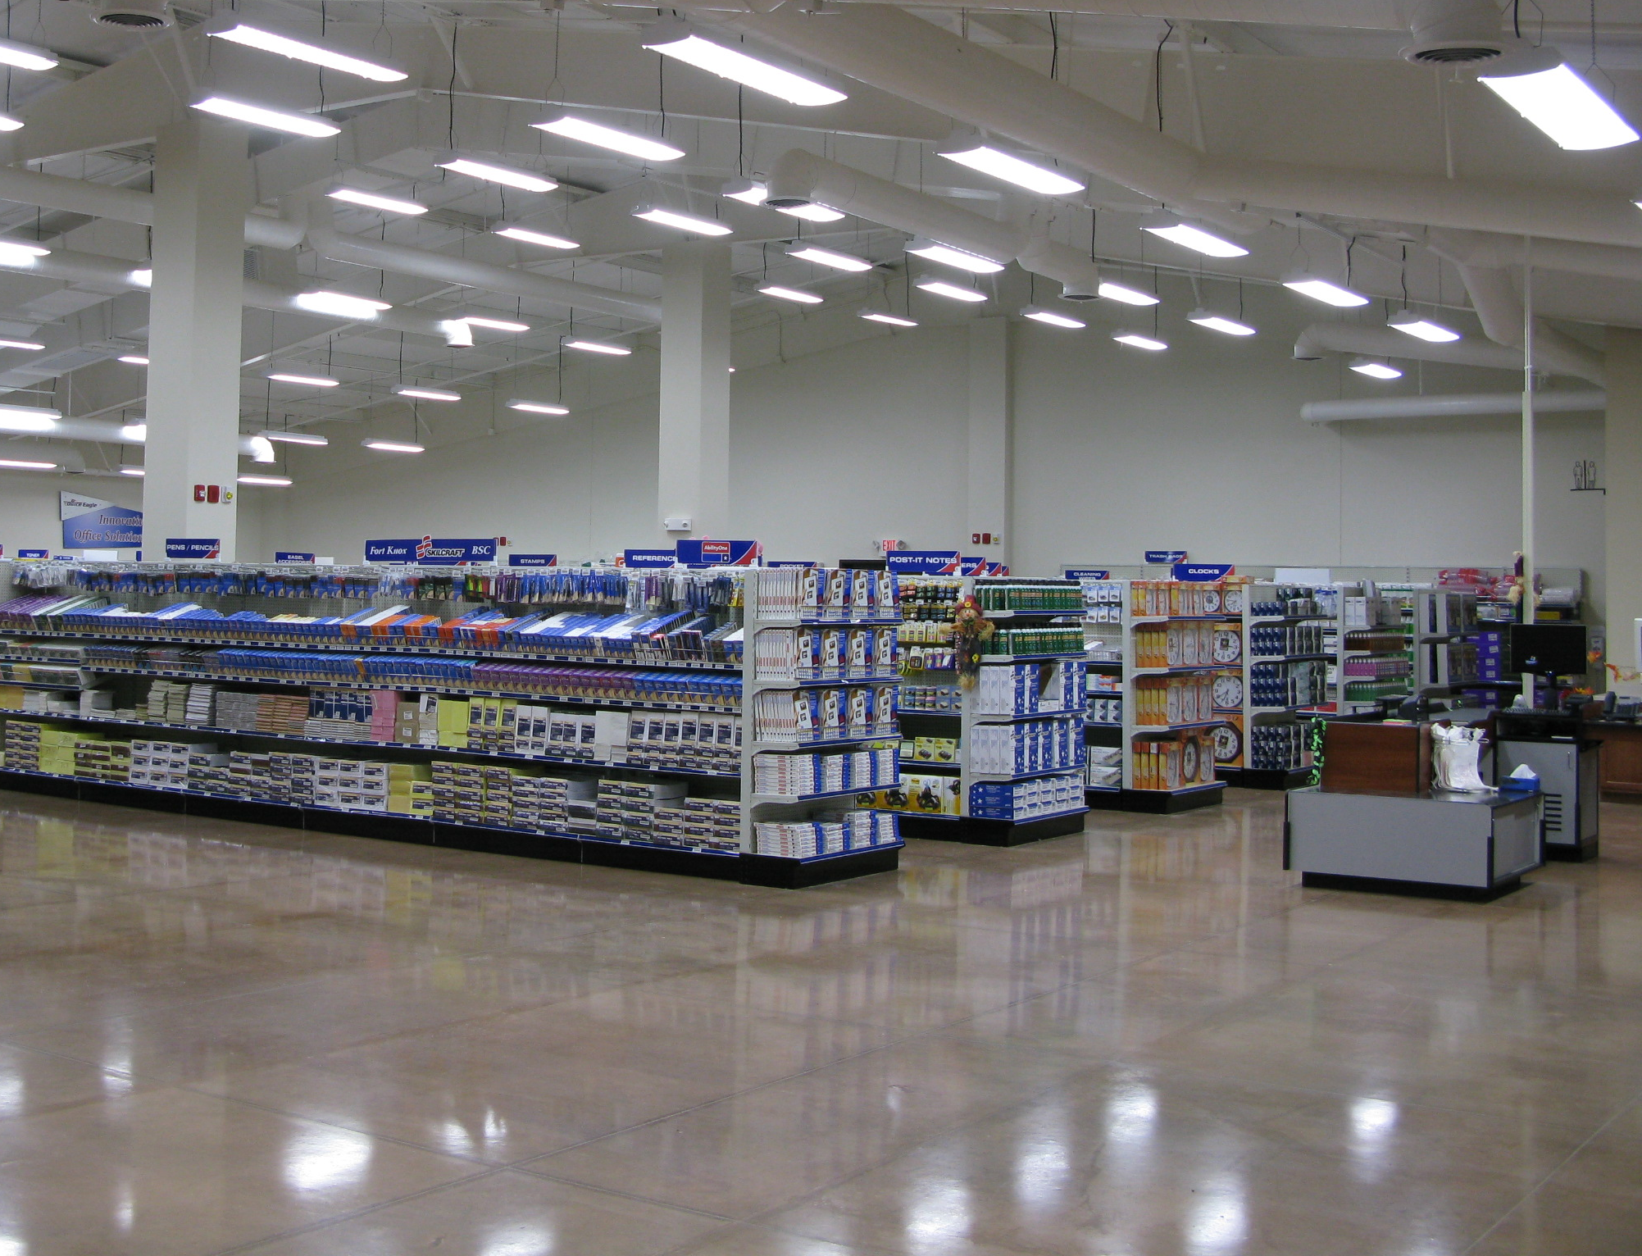
BISM Operated BSCs
Dover AFB, Delaware
Joint Base Anacostia-Bolling, DC
Defense Intelligence Agencies: DC & Reston, VA
Aberdeen Proving Grounds & Edgewood (APG South, MD)
Fort Knox, Kentucky
Joint Base Andrews, MD
Fort Meade, MD (Coming Soon)
Ecommerce: ShopBISM.Com

Slide 12
Thank You For Your Support!
For more information or to get contact info for your BSC, visit www.bism.org/federal
Or contact: Quynh Budzynski; AbilityOne BSC Business Development & Marketing Manager 202-809-9057 qbudzynski@bism.org
7 OUT OF EVERY 10 WORKING-AGE Blind AMERICANS ARE uNEMPLOYED, you can help change that!

